Slide 1
Software Engineering intern experience
Joel Larson
Brandan kalsow
Vanessa Wang
Laura Schultz

Slide 2
Part 00: Introduction

Slide 3
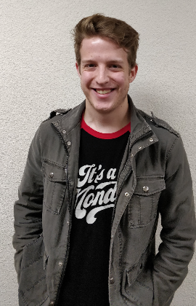

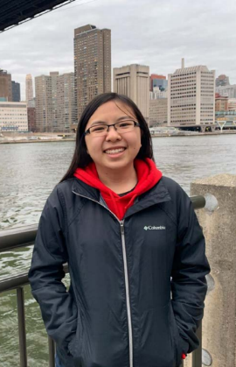

Software Engineering
Intern Team
Joel Larson
Senior
University of Northwestern- St. Paul
Roseville MN
Majors: Computer Science, Applied Mathematics
Hometown: Newton Iowa
Copyright © 2019 by Surescripts, LLC. All rights reserved.

Slide 4

Software Engineering
Intern Team
Brandan Kalsow
Senior
Saint Johns University
Collegeville MN
Major: Computer Science
Hometown: Hudson, WI
Copyright © 2019 by Surescripts, LLC. All rights reserved.

Slide 5
Software Engineering
Intern Team
Vanessa Wang
Junior
Cornell University
Ithaca, NY
Major: Computer Science
Hometown: Richfield, MN
Copyright © 2019 by Surescripts, LLC. All rights reserved.

Slide 6
Software Engineering
Intern Team
Laura Schultz
Senior
Mills College
Oakland, CA
Major: Computer Science
Hometown: St. Paul, MN
Copyright © 2019 by Surescripts, LLC. All rights reserved.

Slide 7
Part 01: Project Background

Slide 8

The Opportunity
Number of product upgrades is increasing due to several factors
Upgrades to the newest version of NCPDP SCRIPT standard
New Surescripts initiatives such as Propel
Copyright © 2019 by Surescripts, LLC. All rights reserved.

Slide 9

The Opportunity
The integration team needs a better way to collect connectivity information
Connectivity Information Includes
IP Addresses
Customer URLs
Certificate Signing Requests
Copyright © 2019 by Surescripts, LLC. All rights reserved.

Slide 10
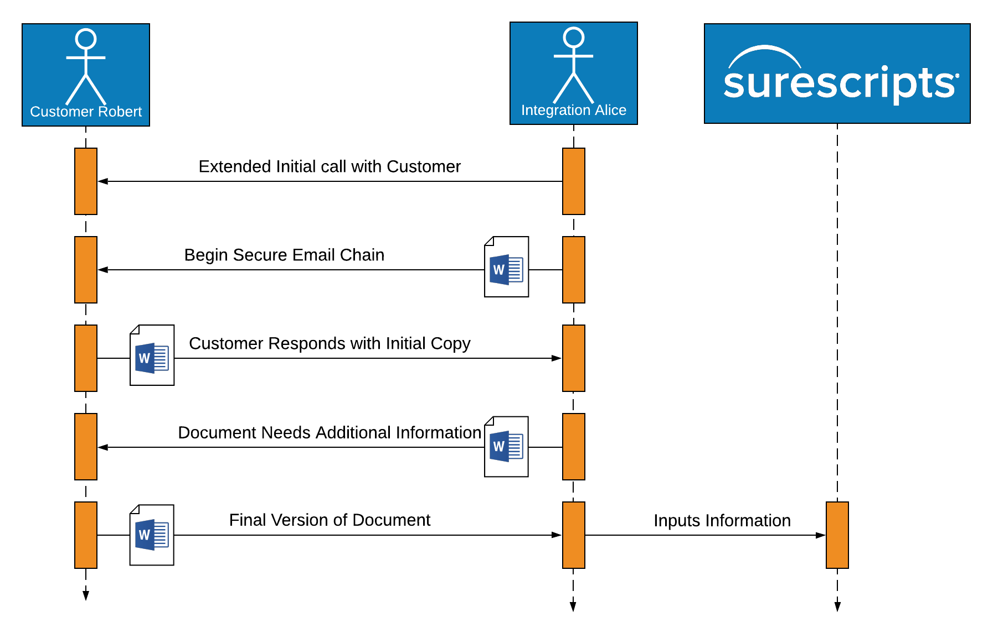
Current Process

Slide 11

OUR PROJECT
Design an application to replace and enhance the integration connectivity forms
Collect connectivity information from customers
Work closely with integration team and tailor project to their needs
Copyright © 2019 by Surescripts, LLC. All rights reserved.
Notes:
Our Solution
Our purpose this summer was to design and build a site to replace this chain of secure email
The focus was on attaining the connectivity information from the customer, but we did not stop there
We wanted to create a source of truth for this information, a landing point for the customer and for the integration manager
We wished to design a smooth way for each party to exchange information and to approve of and request changes
We wished to gather additional information that would help the integration managers along their journey of upgrading a customer

Slide 12
Optimize
Customer
Activation
Project Goals
Real
Time
Validation
Smooth Information Exchange
Enable Automated Setup
Notes:
Comments:
Optimize customer activation
Real Time Validation
Enable automated setup/configuration
Can put down Microsoft word in favor of our microsite

Slide 13
Customer Activation
Project Overview
We have developed a microsite to enhance and replace the word documents
With it, we can gather and store connectivity data, validate complex information in real time, and save integration managers hours of work

Slide 14
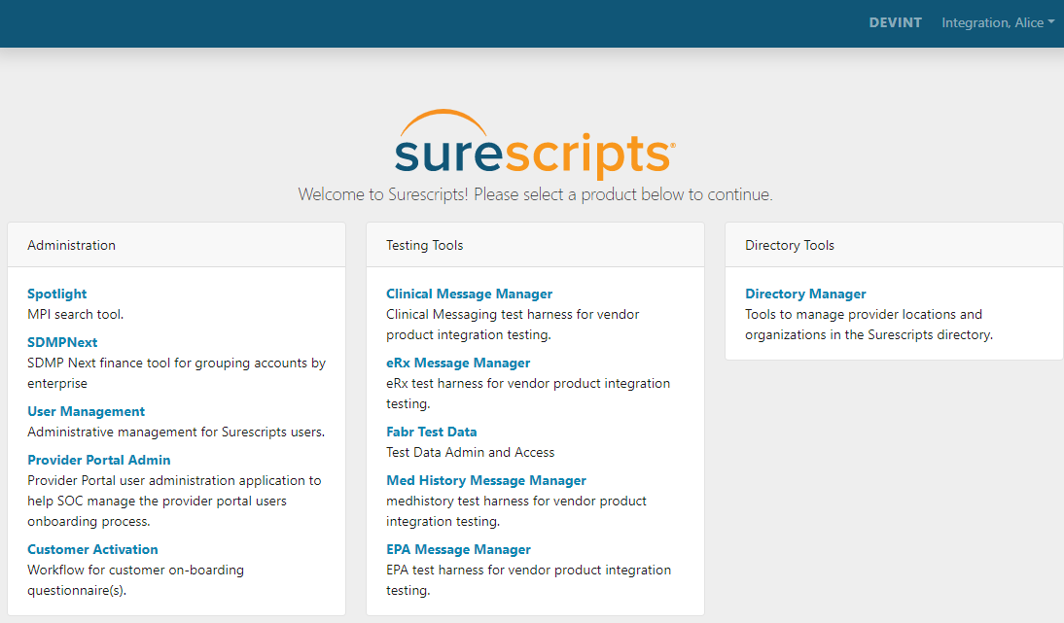
What is a microsite?
Microsite: A web-based tool serving a discrete purpose, usually hosted on a single website with other microsites

Slide 15
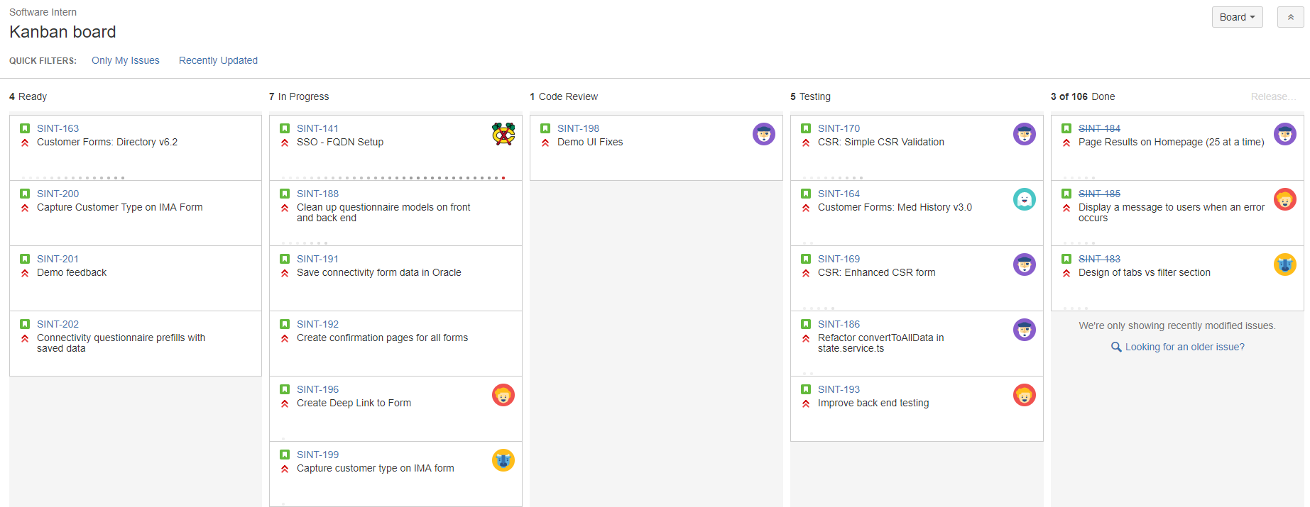
Development Process
Same agile structure as other Surescripts development teams
Shorter sprints
Weekly demos
Kanban board to track work

Slide 16



Project Layout
Angular Typescript & Bootstrap
C# with Oracle Database

Slide 17
Part 10: Workflow

Slide 18
Customer Activation Workflow
Integration:
Create
Customer:
Fill out
Integration:
Approve
Integration Manager creates the connectivity form
Once created, form is sent to customer
Form is saved to home page
Customer fills out connectivity information
Submits to integration manager for approval
Integration Manager reviews customer information
Manager approves form when all information is verified
Notes:
Comments: Might get rid of this slide; easier to jump into the visuals later on
Description of microsite felt a little out of place. Could be better in Brandan’s section

Slide 19
Customer Activation Workflow
Integration:
Create
Customer:
Fill out
Integration:
Approve
Integration Manager creates the connectivity form
Once created, form is sent to customer
Form is saved to home page
Customer fills out connectivity information
Submits to integration manager for approval
Integration Manager reviews customer information
Manager approves form when all information is verified
Notes:
Comments: Might get rid of this slide; easier to jump into the visuals later on
Description of microsite felt a little out of place. Could be better in Brandan’s section

Slide 20
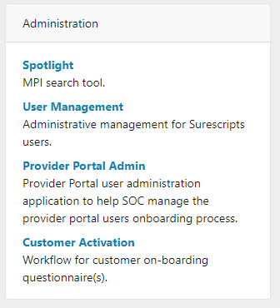
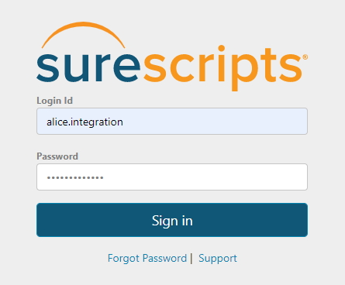
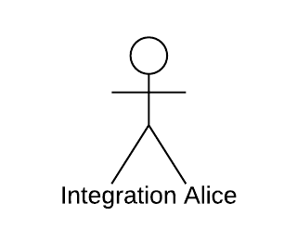
Accessing the Microsite
Customer Activation: one of many microsites
Single Sign On: one account for login
Notes:
As mentioned, our microsite is one of many Surescripts microsites
To access our app, users will log in the same way as other microsites using single sign on
If the customer already has access to another microsite, they will not have to create a new login
Once logged in, the Customer Activation site is listed among the other microsites
Comments: don’t have to make a new account with SSO

Slide 21
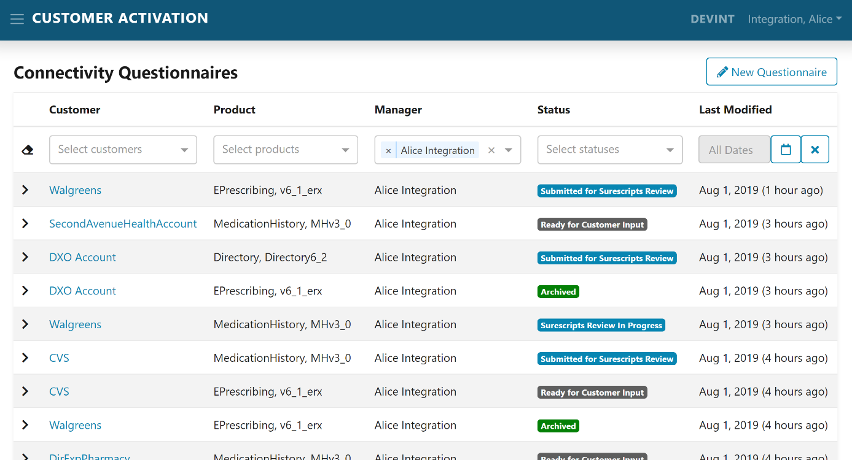
Integration Manager Homepage
Notes:
Integration Manager will see this homepage: table with forms.
Each column represents part of the form:
Customer (who the form is meant for)
Product (the Surescripts product the customer needs)
Manager (the manager that is working on the form)
Status (the stage the form is at)
Last modified

Slide 22
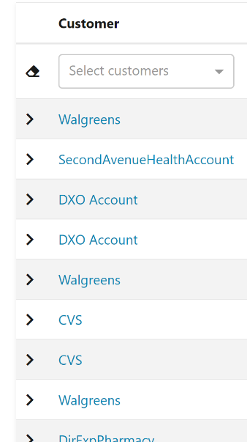
Integration Manager Homepage
Notes:
Integration Manager will see this homepage: table with forms.
Each column represents part of the form:
Customer (who the form is meant for)
Product (the Surescripts product the customer needs)
Manager (the manager that is working on the form)
Status (the stage the form is at)
Last modified

Slide 23
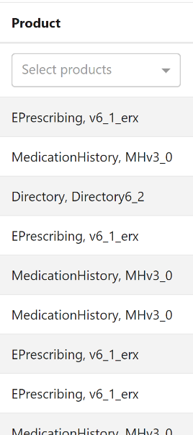
Integration Manager Homepage
Notes:
Integration Manager will see this homepage: table with forms.
Each column represents part of the form:
Customer (who the form is meant for)
Product (the Surescripts product the customer needs)
Manager (the manager that is working on the form)
Status (the stage the form is at)
Last modified

Slide 24
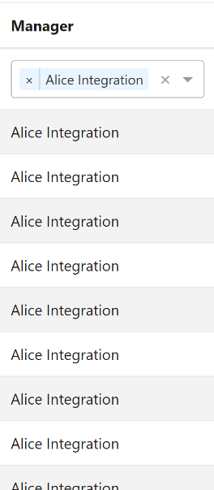
Integration Manager Homepage
Notes:
Integration Manager will see this homepage: table with forms.
Each column represents part of the form:
Customer (who the form is meant for)
Product (the Surescripts product the customer needs)
Manager (the manager that is working on the form)
Status (the stage the form is at)
Last modified

Slide 25
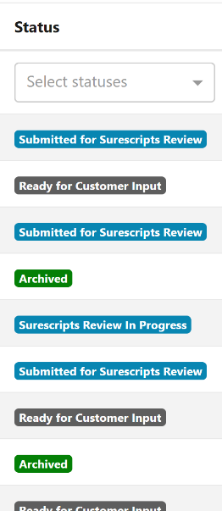
Integration Manager Homepage
Notes:
Integration Manager will see this homepage: table with forms.
Each column represents part of the form:
Customer (who the form is meant for)
Product (the Surescripts product the customer needs)
Manager (the manager that is working on the form)
Status (the stage the form is at)
Last modified

Slide 26
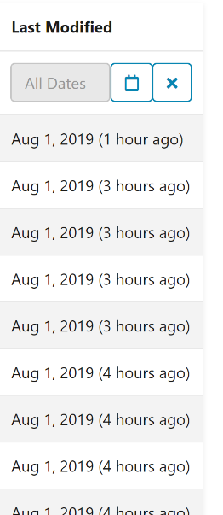
Integration Manager Homepage
Notes:
Integration Manager will see this homepage: table with forms.
Each column represents part of the form:
Customer (who the form is meant for)
Product (the Surescripts product the customer needs)
Manager (the manager that is working on the form)
Status (the stage the form is at)
Last modified (last modified)

Slide 27
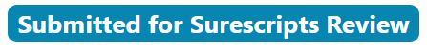
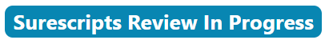
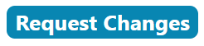
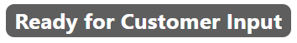
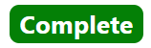
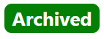
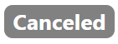
Homepage: Status Codes
Integration Manager
Submitted for Surescripts Review
Surescripts Review In Progress
Request Changes
Customer
Ready For Customer Input
Completed Forms
Complete
Archived
Canceled
Notes:
Multiple forms at multiple stages, so we created a color code
The integration manager has actions to do
The customer has actions to do
Completed forms, which can be filed away or used for future reference
Canceled, if a manager does not need to work with a customer anymore
Request Changes → IMA does stuff → Ready for Customer Input

Slide 28
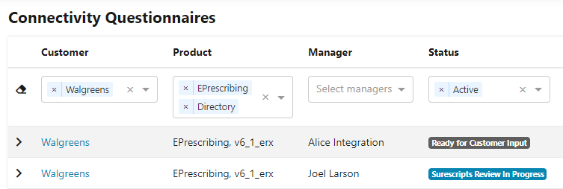
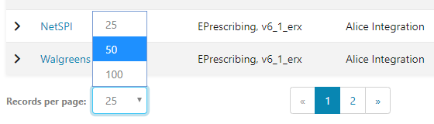
Homepage: Filter and Pagination
Integration Manager has many forms to work with
Ability to filter and page through results
Notes:
Integration managers are working with several forms at once
Ability to page through forms and filter through them
Pagination is important since we’re loading forms from the database
Helps with usability since we aren’t loading all forms at once and slowing down the page
Filtering if the manager knows what customer to look for
Optional: Status groups, last modified calendar

Slide 29
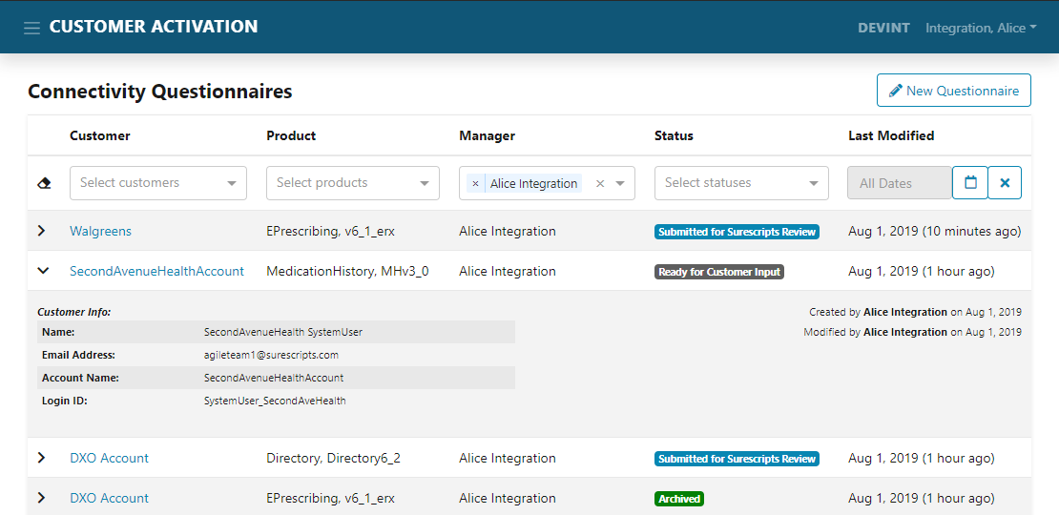
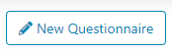
Homepage: Actions
Integration Manager Actions
Create new questionnaire
Confirm form in progress
Notes:
- After explaining what the homepage represents, the integration manager has a few actions they can do
Can either create a new form or work with existing form
To start off workflow, the integration manger will create a new form (after they have made contact with the customer)

Slide 30
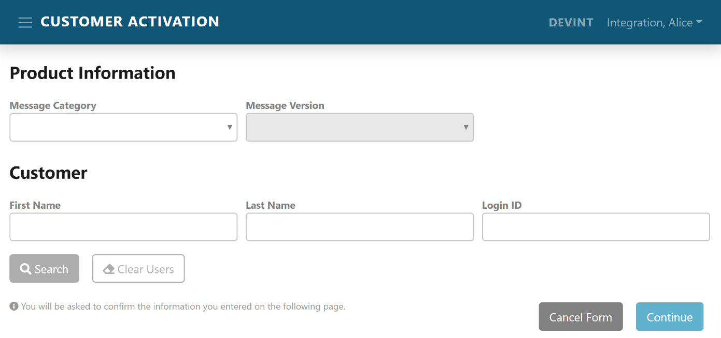
New Questionnaire

Slide 31
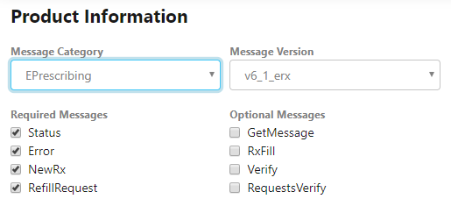
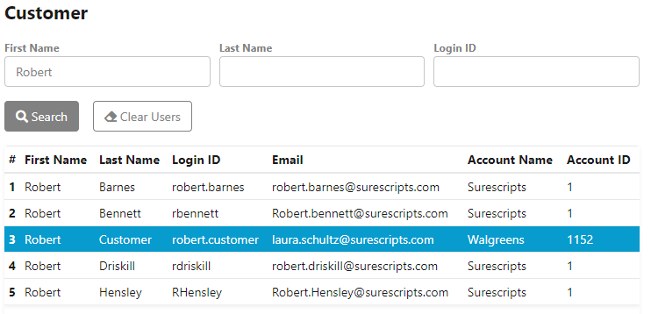
New Questionnaire
Message Category, Message Version, and Customer
Database queries: information always up-to-date

Slide 32
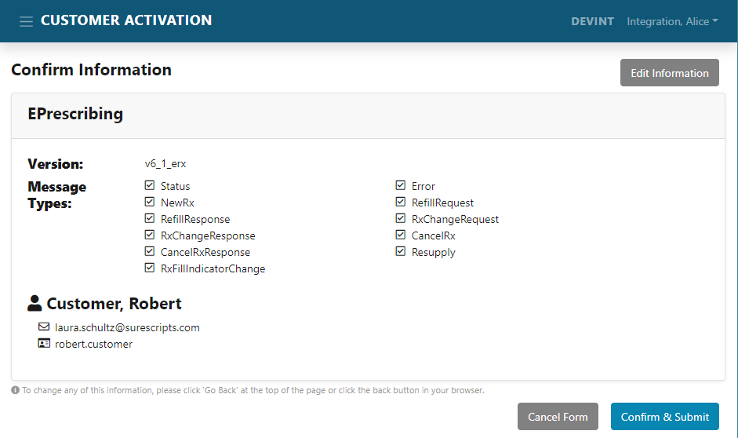
New Questionnaire
Confirmation Page (review info)

Slide 33
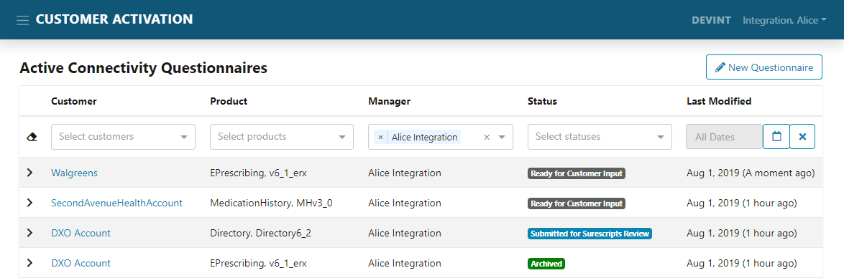
New Questionnaire
Form is inserted into the database
New row appears on homepage

Slide 34
Customer Activation Workflow
Integration:
Create
Customer:
Fill out
Integration:
Approve
Integration Manager creates the connectivity form
Once created, form is sent to customer
Form is saved to home page
Customer fills out connectivity information
Submits to integration manager for approval
Integration Manager reviews customer information
Manager approves form when all information is verified
Notes:
Comments: Might get rid of this slide; easier to jump into the visuals later on
Description of microsite felt a little out of place. Could be better in Brandan’s section

Slide 35
Customer Application View
After the Integration Manager has entered the relevant project information, the customer must fill out their form.
The customer form is generated based on information that the Integration Manager has entered.
Currently, the questionnaire supports three Surescripts products: ePrescribing, Directory, and MedHistory.

Slide 36
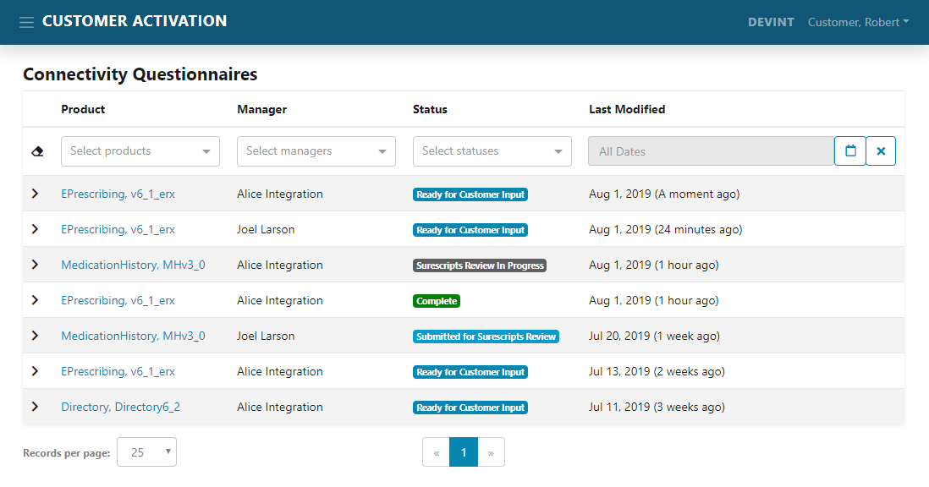
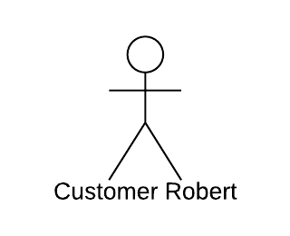
Customer Homepage
Customer logs in to homepage; new form has been created
Begin filling out the form

Slide 37
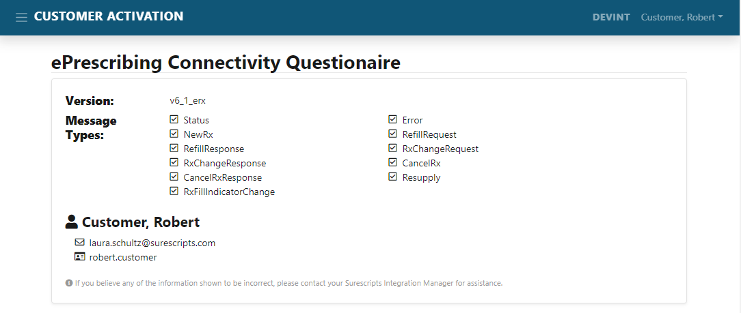
Customer Questionnaire
Info entered by the Integration Manager appears at the top
Customer can confirm that project info is correct

Slide 38
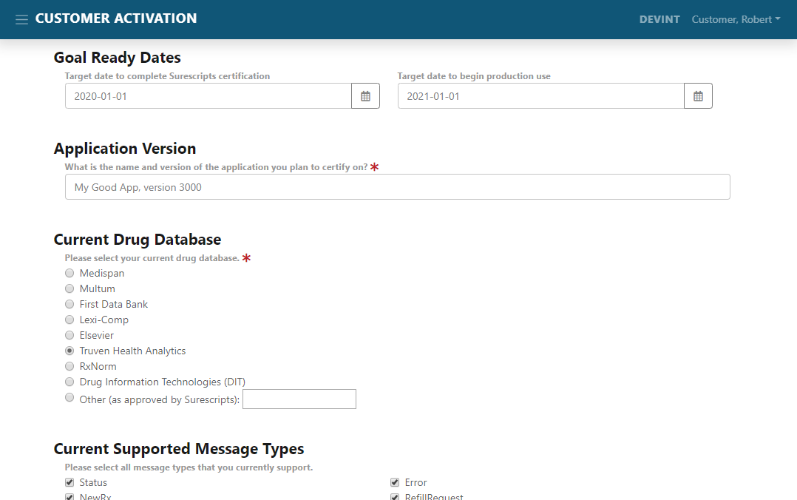
Customer Questionnaire
The customer has a set of questions to fill out
Some questions have answers that are generated via Surescripts Routing

Slide 39
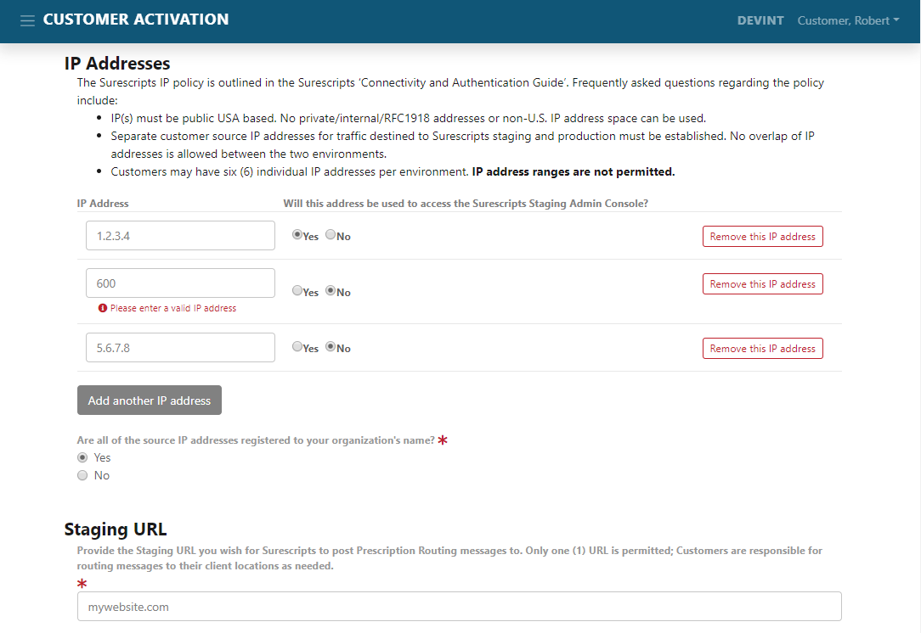
Customer Questionnaire
Includes information about how we connect to a customer and how they connect to us
Basic validation for IP addresses

Slide 40
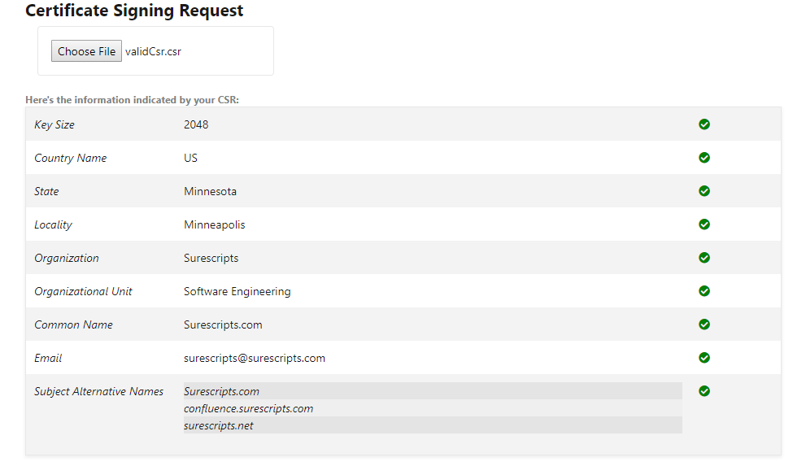
Certificate Signing Request
30% of E-Prescribing 2017071 projects require mTLS troubleshooting.
We help customers create their CSR by validating the info they send

Slide 41
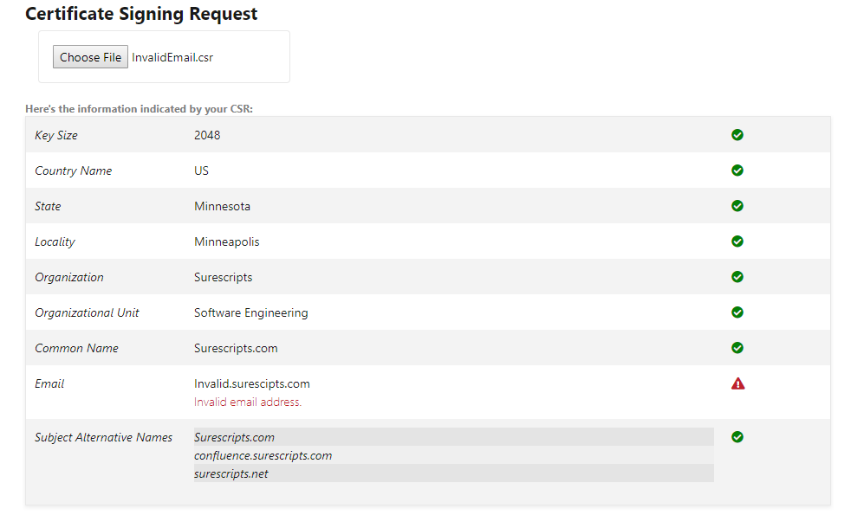
Certificate Signing Request
If any fields are invalid, the system will display an error message
We hope that the instant feedback will make the activation process easier for both the customer and the Integration Manager

Slide 42
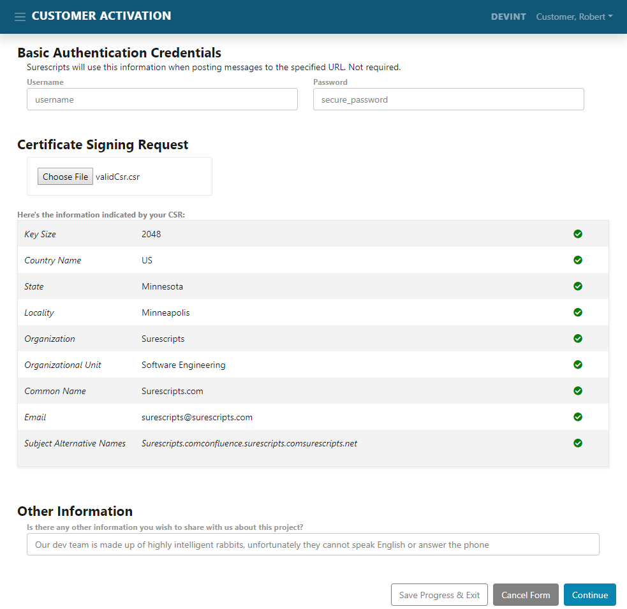
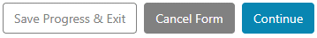
Customer submission
Customer clicks “Continue” after answering questions
They also have the opportunity to save their responses without submitting
Notes:
After the customer submits their responses to the questionnaire, it goes back to the Integration Manager for review
Their answers are saved in the database so that they can be retrieved later
If the Integration Manager approves the questionnaire, they can begin the work of getting the customer set up in Salesforce and Surescripts Admin Console

Slide 43
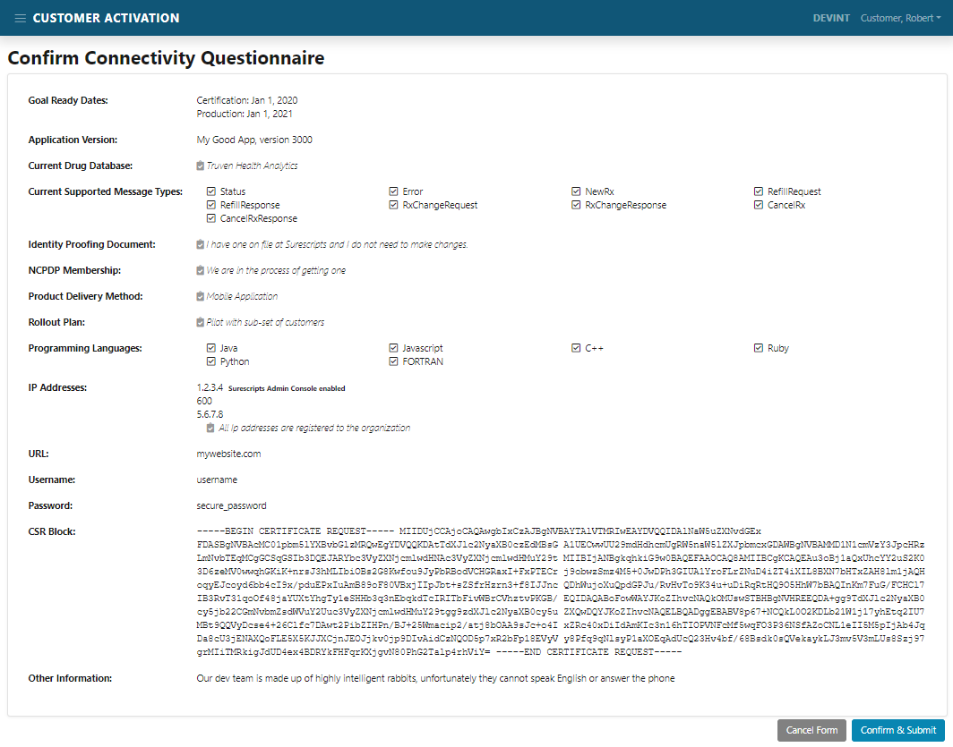
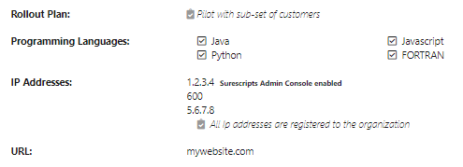
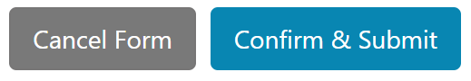
Customer confirm page
Customer has a chance to review their answers before submitting questionnaire to the database
Notes:
30% of E-Prescribing 2017071 projects require mTLS troubleshooting. Many are related to incorrect CSRs
Over 20 Level 3 Support cases on mTLS issues in the last 60 days

Slide 44
Customer Activation Workflow
Integration:
Create
Customer:
Fill out
Integration:
Review
Integration Manager creates the connectivity form
Once created, form is sent to customer
Form is saved to home page
Customer fills out connectivity information
Submits to integration manager for approval
Integration Manager reviews customer information
Manager approves or sends back to customer for more information
Notes:
Comments: Might get rid of this slide; easier to jump into the visuals later on
Description of microsite felt a little out of place. Could be better in Brandan’s section

Slide 45
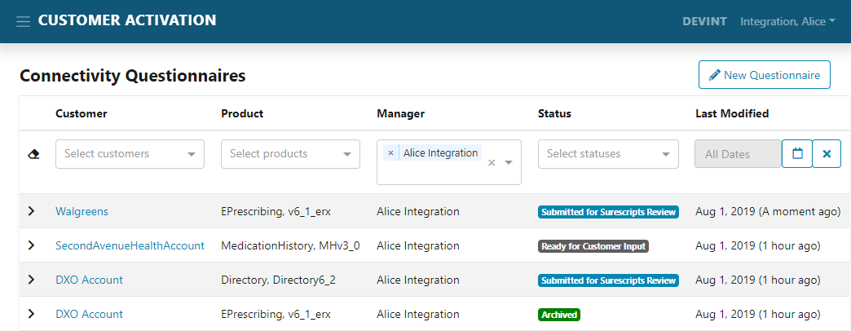
Integration Manager Homepage
Here, the Integration Manager can see that the customer has filled out their questionnaire. Clicking on the customer will route to the view page.

Slide 46
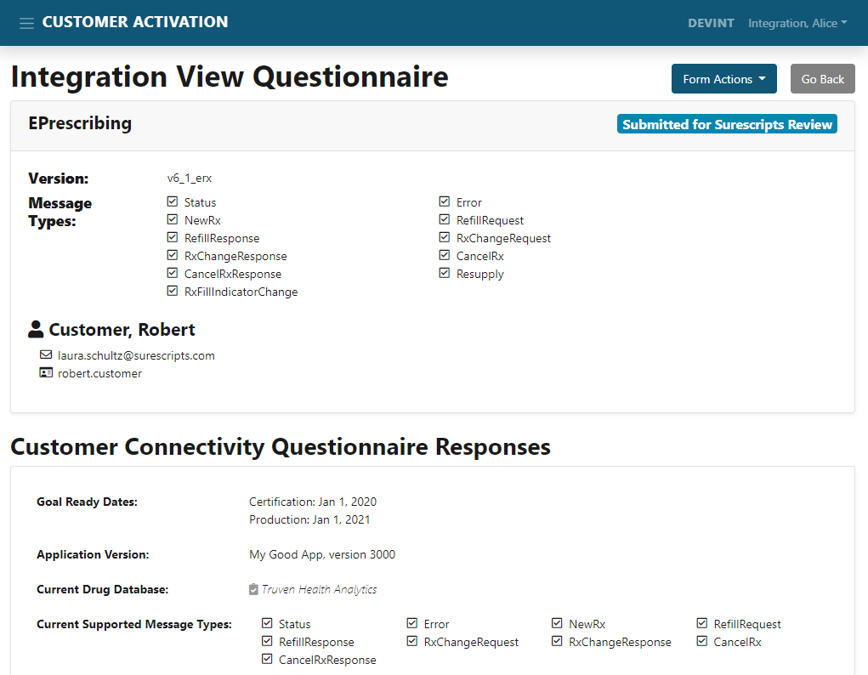
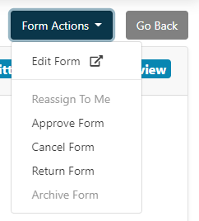
Actions
Integration Manager has a variety of form actions available to them
Notes:
Edit Form
Reassign To Me
Approve Form
Cancel Form
Return Form
Archive Form

Slide 47
Optimize
Customer
Activation
Project Goals
Real
Time
Validation
Smooth Information Exchange
Enable Automated Setup
Notes:
Comments:
Optimize customer activation
Real Time Validation
Enable automated setup/configuration
Can put down Microsoft word in favor of our microsite

Slide 48

Feedback
Feedback from Surescripts Integration Managers:
“I’m ecstatic about this application, it is going to save us soooo much time”
“The interns really made a tool that knocked my socks off”
“I’m giddy excited, IT VALIDATES CSRs on THE CUSTOMER SIDE!”
“Interns are knocking it out of the park”
“Super excited about this application”
Copyright © 2019 by Surescripts, LLC. All rights reserved.
Notes:
Comments: Don’t have to read each one; can say the IMA team loved our app. Can connect quotes more to the CSR since it’s technical and will give an idea of how important it was

Slide 49
Next Steps
We will hand off this project to another Surescripts agile team in the coming days
They will work on getting it into staging to pilot with customers
Ultimately, it will be hosted in the portfolio of trading partner tools

Slide 50


WHAT
WE
LEARNED
New languages and frameworks
Angular, C#, Oracle, etc.
Developing a product as a team
Sharing workload, best practices, effective teamwork skills
Communicating with end users
Using technical vs non-technical language
Key takeaways from our experience this summer
Role of Surescripts in healthcare
How Surescripts helps patients receive better care
Copyright © 2019 by Surescripts, LLC. All rights reserved.
Notes:
Comments: Great slide

Slide 51

Thank you
Sponsors
Michael Rosenthal
Andrew Lind
Mentors
Allison Mohr
Joe Athman
Eric Kaufman
Ryan Wiegel
Charles Oberg – Database Engineer
James McMahon – Integration Manager
Copyright © 2019 by Surescripts, LLC. All rights reserved.

